Slide 1





TECHNOMATCH’23
Stock market price prediction

Slide 2
Your best quote that reflects your approach… “It’s one small step for man, one giant leap for mankind.”
- Neil Armstrong

Slide 3
STOCK PRICE PREDICTION
ADARSH KUMAR
ARYAN KAUSHIK
DHRUV SINGH

Slide 4
INTRODUCTION
The objective of this project is to analyse the stock market to predict its future price so that the investors and the company can make better informed decision about the stock price.
The algorithm used is LSTM(Long Short-Term Memory) due to its capability of storing past information which makes it useful to predict stock prices.

Slide 5
DATASET
This dataset contains the historical price of Microsoft stocks from 1986 to current date. There are 9337 data points and 7 features.
The features are:-
Date: The date of the stock traded
Open: The opening stock price of that day
Close: The closing stock price of that day
High: The highest price of the stock reached on the date

Slide 6
DATASET
Low: The lowest price of the stock reached on the day
Adjusted Close: The closing price of the stock after dividends payout
Volume: The number of stocks traded on the day

Slide 7
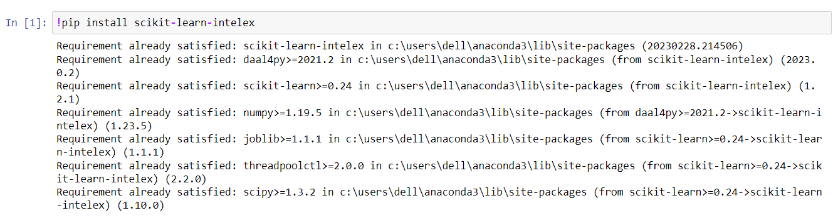
INVOKATION OF INTEL ONE API

Slide 8
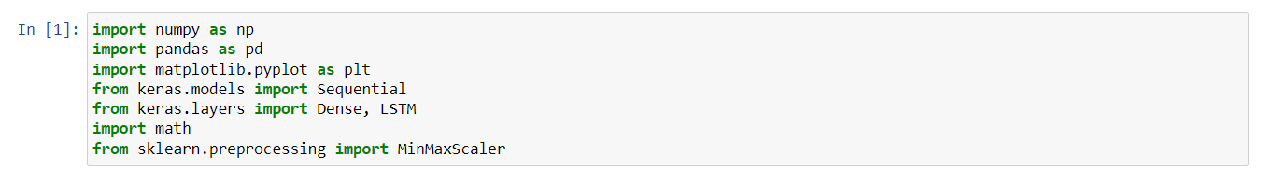
IMPORT LIBRARIES

Slide 9
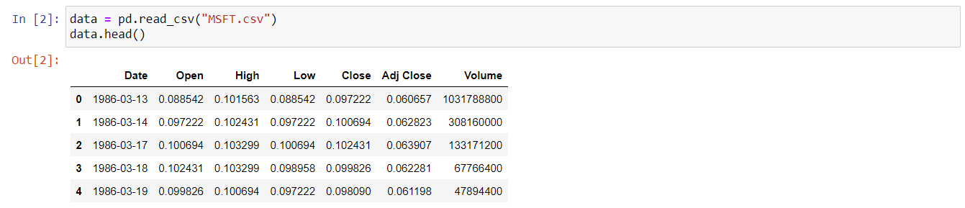
DIMENSIONAL ANALYSIS OF DATASET

Slide 10
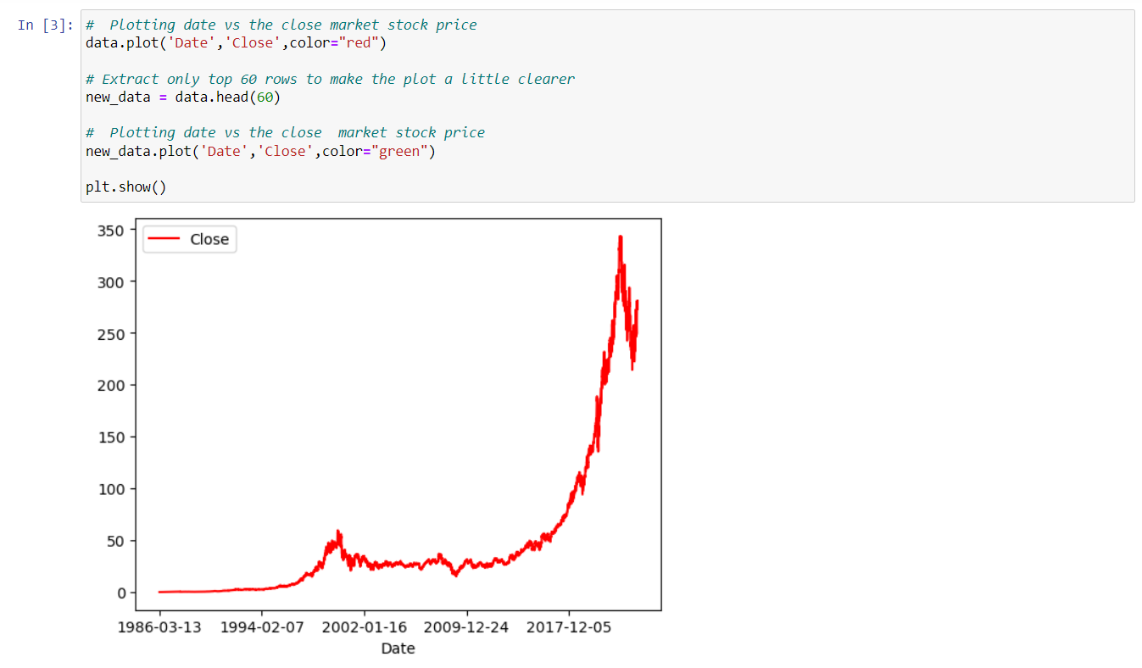
DATA VISULAIZATION

Slide 11
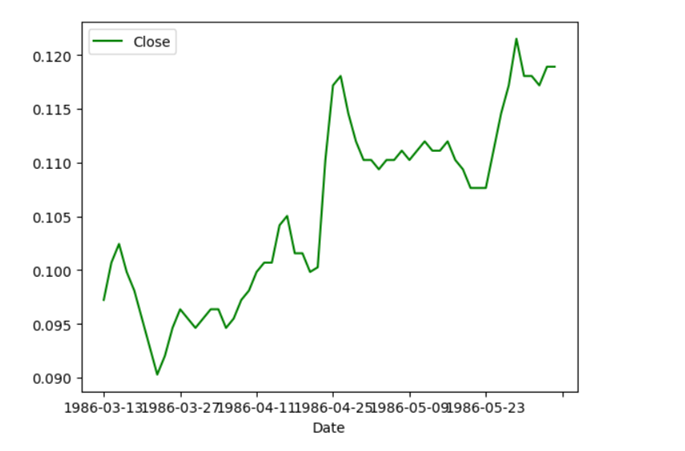
DATA VISUALIZATION

Slide 12
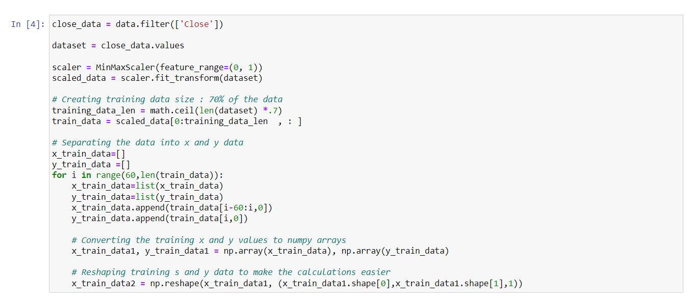
MODEL CREATION

Slide 13
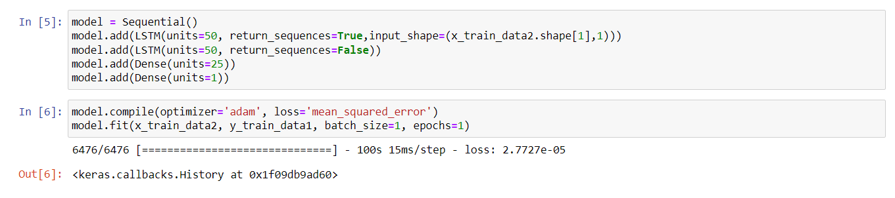
MODEL TRAINING

Slide 14
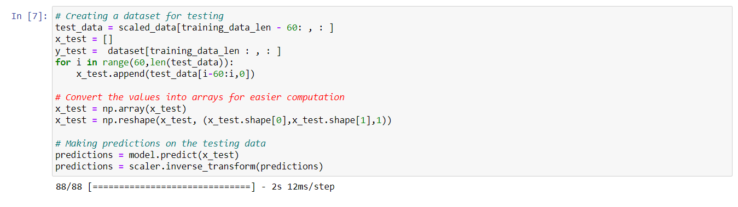
MODEL TESTING

Slide 15
ROOT MEAN SQUARED ERROR

Slide 16
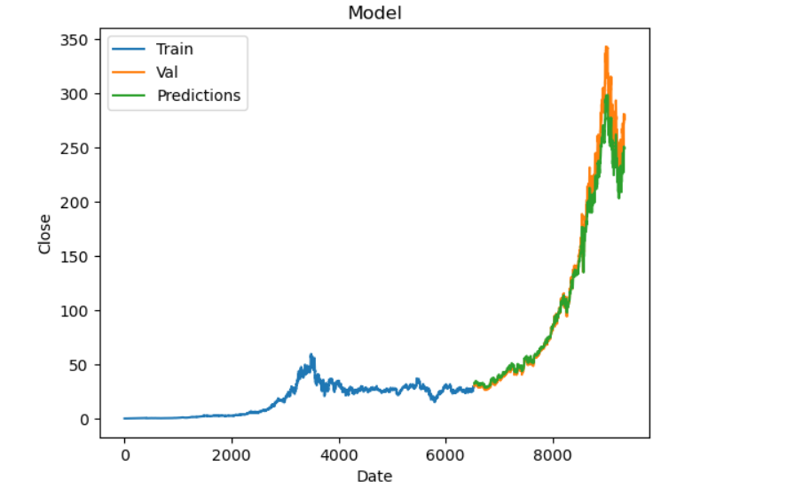
MODEL VISUALIZATION

Slide 17
CONLUSION
This project was designed to predict the future price of Microsoft stock for investors to have an idea of where the stock prices may be in the future.
Our model gives a plot between actual and predicted stock prices of Microsoft with an accuracy of 93.8%.

Slide 18
REFERENCE AND LINKS
Database Reference :- https://finance.yahoo.com/quote/MSFT/history
GitHub Link :- https://github.com/Ablazer16/StockMaket

Slide 19
THANK YOU

